Slide 1
Cell Architecture
By Paul Zimmons

Slide 2
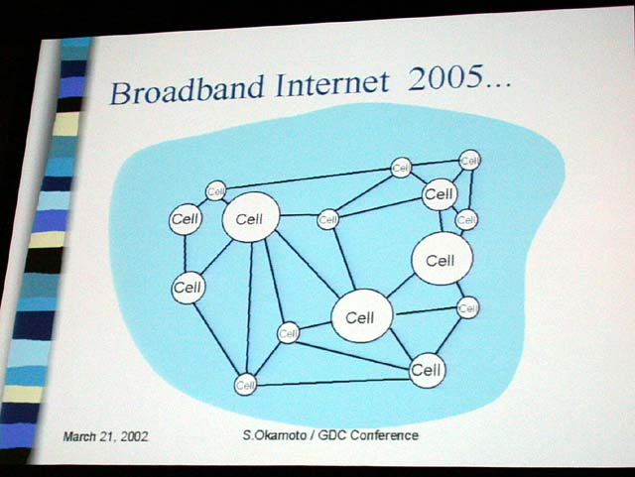
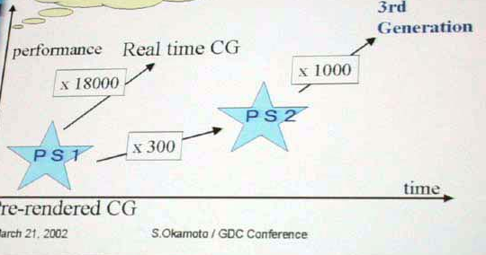
Brief History
March 12, 2001 – “Cell” announced
  “supercomputer-on-a-chip”
  $400M ; 5 years ; 300 engineers ; 0.1 micron
  Revised 4/8/2002 to include 0.05 micron development
2001 Ken Kutaragi Interview – “One CELL has a capacity to have 1 TFLOPS performance”
March, 2002 – GDC – Shin’ichi Okamoto speech
  2005 target date, first glimpse of cell idea, 1000x figure

Slide 3
Brief History II
August, 2002 – Cell design finished (near “tape out”)
  “4-16 general-purpose processor cores per chip”
November, 2002 – Rambus licenses “Yellowstone” technology to Toshiba
  Yellowstone– 3.2-6.4 Ghz memory – 50-100 Gbytes/sec (according to Rambus)
January, 2003 – Rambus licenses Yellowstone/Redwood to Sony
  Redwood – parallel interface between chips (10x current bus speeds, 40-60 GB/s?)
January, 2003 – Inquirer story
  Cell at 4 Ghz, 1024 bit bus, 64 MB memory, PowerPC
  Patent 20020138637

Slide 4
Patent Search
20020138637 - Computer architecture and software cells for broadband networks
  NOTE: All images are adapted from this patent
20020138701 - Memory protection system and method for computer architecture for broadband networks
20020138707 - System and method for data synchronization for a computer architecture for broadband networks
20020156993 - Processing modules for computer architecture for broadband networks
No graphics patents ☹ (that I could find)

Slide 5
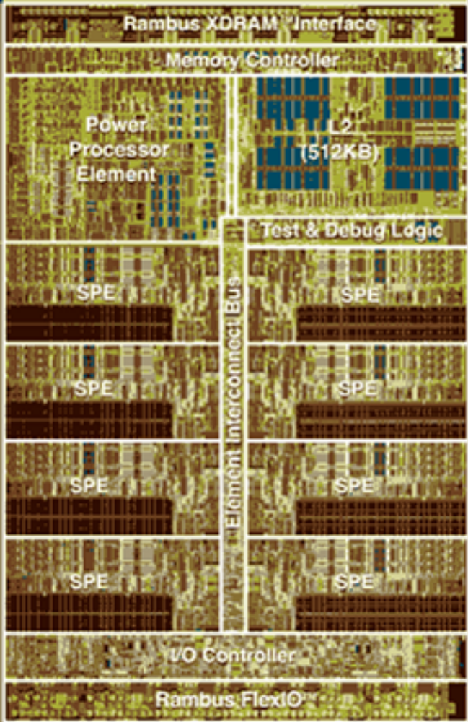
Introduction
Introduction
The Cell concept was originally thought up by Sony Computer Entertainment inc. of Japan, for the PlayStation 3
The architecture as it exists today was the work of three companies: Sony, Toshiba and IBM
http://www.blachford.info/computer/Cell/Cell0_v2.html
http://domino.research.ibm.com/comm/research.nsf/pages/r.arch.innovation.html

Slide 6

Why Cell?
Sony and Toshiba (being major electronics manufacturers) buy in all manner of different components. One of the reasons for Cell's development is they want to save costs by building their own components.
Next generation consumer technologies such as Blu-ray, HDTV, HD Camcorders and of course the PS3 will all require a very high level of computing power and they are going to need the chips to provide it.
Cell will be used for all of these and more, IBM will also be using the chips in servers. The partners can also sell the chips to 3rd party manufacturers

Slide 7
What is Cell?
Cell is an architecture for high performance distributed computing.
It is comprised of hardware and software Cells, software Cells consist of data and programs (known as jobs or apulets), these are sent out to the hardware Cells where they are computed, the results are then returned
According to IBM the Cell performs 10x faster than existing CPUs on many applications.

Slide 8
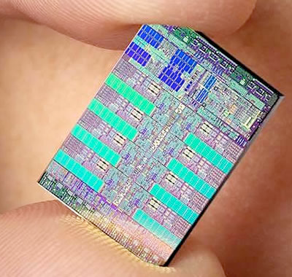
What is a Cell?
A computer architecture (a chip)
  High performance, modular, scalable
  Composed of Processing Elements
A programming model
  Cell Object or Software Cell
    Program + Data = “apulet”
    State processing requirements, setup the hardware/memory, process the data
  Similar to Java but no virtual machine
    All Cell-based products have the same ISA but can have different hardware configurations
Computational Clay

Slide 9
Specifications
A hardware Cell is made up of:
1 Power Processor Element (PPE).
8 Synergistic Processor Elements (SPEs). or APU = additional processing unit
Element Interconnect Bus (EIB).
Direct Memory Access Controller (DMAC).
2 Rambus XDR memory controllers.
Rambus FlexIO (Input / Output) interface.

Slide 10
Overall Picture
Software Cells
Cell
Cell
Cell
Cell
Cell
Cell
Cell
Cell
Cell
Cell
Cell
Cell
Cell
Cell
Cell
Cell
Cell
Cell
Cell
Cell
……..
Cell
Cell
Cell
Cell
Server
Visualizer
Client
Network
Cell
Cell
Cell
Cell
Cell
Cell
Cell
Cell
Cell
Cell
Cell
Cell
Cell
Cell
Cell
Cell
Cell
Cell
Cell
……..
Cell
Cell
Cell
Cell
Cell
Cell
Cell
Cell
PDA
Server
Visualizer
Cell
Cell
PDA
Client
DTV

Slide 11
Processor Elements (PEs)
Cell chips are composed of Processor Elements
Processor Element
PE
Bus
DRAM
PU
DRAM
DMAC
APU
PE
PE
PE
PE
APU
APU
APU
APU
APU
Possible Cell Configuration
APU

Slide 12
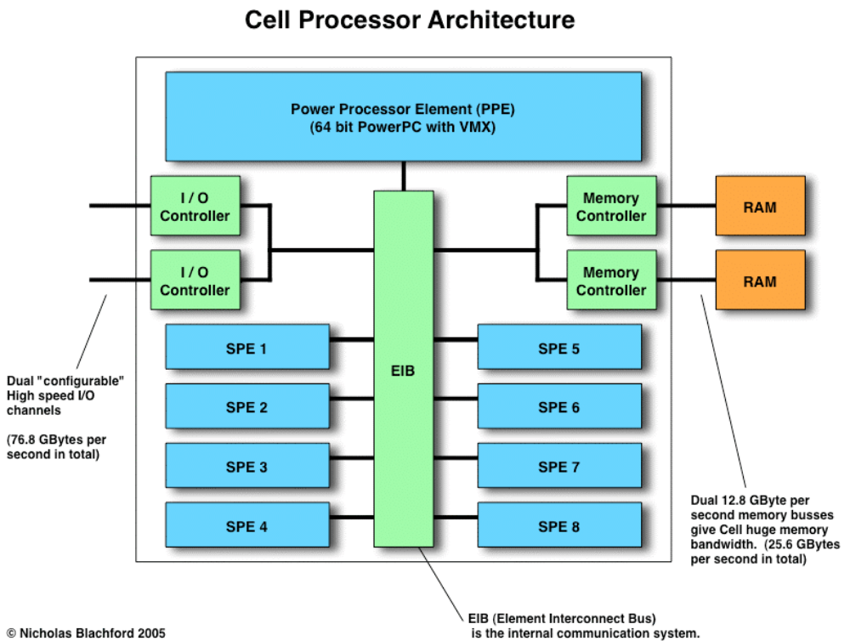

Slide 13

PEs Continued
PU = Processor Unit ( ~PPE Power Processor Element )
  General Purpose, Has Cache, Coordinates APUs
  Most likely a PowerPC core (4Ghz?)
DMAC = Direct Memory Access Controller
  Handles DRAM accesses for PU, APUs
  Reads/writes 1024 bit blocks of data
  APU = additional processing unit
      (~SPE Synergistic Processor Elements )
  8 APUs in a PE (preferably)

Slide 14
Processor Element (PE)
The PE is a conventional microprocessor core which sets up tasks for the APU (SPEs) to do.
In a Cell based system the PPE will run the operating system and most of the applications but compute intensive parts of the OS and applications will be offloaded to the SPEs.
The PE is a 64 bit, "Power Architecture" processor with 512K cache.
While the PE uses the PowerPC instruction set, it is not based on an existing design on the market today.
That is to say, it is NOT based on the existing 970 / G5 or POWER processors.
It is a completely different architecture so clock speed comparisons are completely meaningless.

Slide 15
Processor Element (PE)
The PPE is a dual issue, dual threaded, in-order processor.
Unlike many modern processors the hardware architecture is an “old style” RISC design, i.e. the PPE has a relatively simple architecture.
Such a simple CPU needs the compiler to do a lot of the scheduling work that hardware usually does so a good compiler will be essential.
Most modern microprocessors devote a large amount of silicon to executing as many instructions as possible at once by executing them "out-of-order" (OOO).

Slide 16
APU (SPEs)
Cell
32 GFLOPS and 32 GOPS (integer)
No cache
4 floating point units, 4 integer units (preferably)
128 Kbytes local storage (LS) as SRAM
LS includes program counter and stack
128 registers at 128 bits/register
1 word = 128 bits
“calculation” = 3 words = 384 bits
Work independently
PE
PU
DMAC
APU
8
APU
384
APU
Local
Storage
SRAM
128 KB
256
128
Registers
1024
128
Floating Point Units
128 bits
384
instruction
Integer Units
128 bits
128

Slide 17
APU (SPE) Local Stores
Like the PE, the SPEs are in-order processors and have no Out-Of-Order capabilities. This means that as with the PPE the compiler is very important. The SPEs do however have 128 registers and this gives plenty of room for the compiler to unroll loops and use other techniques which largely negate the need for OOO hardware.
One way in which SPEs operate differently from conventional CPUs is that they lack a cache and instead use a “Local Store”. This potentially makes them slightly) harder to program but they have been designed this way to reduce hardware complexity and increase performance.

Slide 18
APU (SPE) Local Stores
To solve the complexity associated with cache design and to increase performance the Cell designers took the radical approach of not including any.
Instead they used a series of 256 Kbyte “local stores”, there are 8 of these, 1 per SPE. Local stores are like cache in that they are an on-chip memory but the way they are constructed and act is completely different.
The SPEs operate on registers which are read from or written to the local stores. The local stores can access main memory in blocks of 1Kb minimum (16Kb maximum) but the SPEs cannot act directly on main memory (they can only move data to or from the local stores).
Caches can deliver similar or even faster data rates but only in very short bursts (a couple of hundred cycles at best), the local stores can each deliver data at this rate continually for over ten thousand cycles without going to RAM.

Slide 19
SPE Local Stores
One potential problem is that of “contention”. Data needs to be written to and from memory while data is also being transferred to or from the SPE’s registers and this leads to contention where both systems will fight over access slowing each other down.
To get around this the external data transfers access the local memory 1024 bits at a time, in one cycle (equivalent to a transfer rate of 0.5 Terabytes per second!).
This is just moving data to and from buffers but moving so much in one go means that contention is kept to a minimum.

Slide 20
Element Interconnect Bus (EIB)
The EIB consists of 4 x 16 byte rings which run at half the CPU clock speed and can allow up to 3 simultaneous transfers. The theoretical peak of the EIB is 96 bytes per cycle (384 Gigabytes per second) however, according to IBM only about two thirds of this is likely to be achieved in practice.

Slide 21
Cell Characteristics
A big difference in Cells from normal CPUs is the ability of the SPEs in a Cell to be chained together to act as a stream processor [Stream] . A stream processor takes data and processes it in a series of steps.

Slide 22
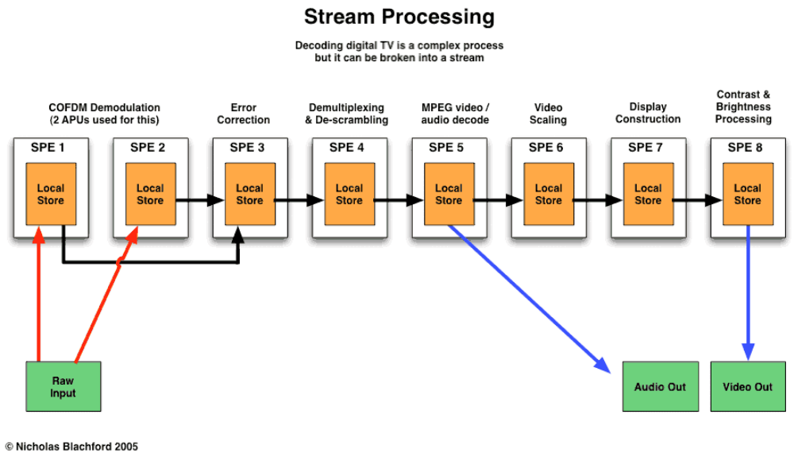
Cell Architecture

Slide 23
PE Detail
PU
DMAC
FPU
FPU
FPU
FPU
LS
Reg
IU
IU
IU
IU
FPU
FPU
FPU
FPU
LS
Reg
32 Gflops x 8
=
256 Gflops/PE
IU
IU
IU
IU
FPU
FPU
FPU
FPU
LS
Reg
IU
IU
IU
IU
FPU
FPU
FPU
FPU
LS
Reg
IU
IU
IU
IU
FPU
FPU
FPU
FPU
LS
Reg
IU
IU
IU
IU
FPU
FPU
FPU
FPU
LS
Reg
IU
IU
IU
IU
FPU
FPU
FPU
FPU
LS
Reg
IU
IU
IU
IU
FPU
FPU
FPU
FPU
LS
Reg
IU
IU
IU
IU

Slide 24
Other Configurations
More or less APUs
Can have graphics called a Visualizer (VS)
  Visualizer uses a Pixel Engine, a Framebuffer, and a Cathode Ray Tube Controller (CRTC)
  No info on Visualizer or Pixel Engine that I could find
Configs can also include an optical interface on the chip package
Processing
Configuration
Graphics
Configuration
PU
PU
PU
DMAC
DMAC
DMAC
APU
APU
APU
APU
APU
Pixel
Engine
APU
APU
APU
APU
APU
Image
Cache
APU
APU
APU
Visualizer
CRTC
APU
Visualizer
PDA
Configuration
APU
APU

Slide 25
Broadband Engine (BE)
Cell version of the Emotion Engine
DRAM
PU
PU
PU
PU
DMAC
DMAC
DMAC
DMAC
I/O
APU
APU
APU
APU
APU
APU
APU
APU
APU
APU
APU
APU
APU
APU
APU
APU
APU
APU
APU
APU
APU
APU
APU
APU
APU
APU
APU
APU
APU
APU
APU
APU
BE Bus

Slide 26
Stuffed Chips
No way you can fit 128 FPUs plus 4 PowerPC cores on a chip!
  No caches leave much more room for logic
    For streaming applications this is not that bad
  NV30
    0.13 micron
    130 M Transistors
    51 Gflops (32 128-bit FPUs)
  Itanium 2
    0.13 micron
    410 M Transistors
    8 Gflops

Slide 27
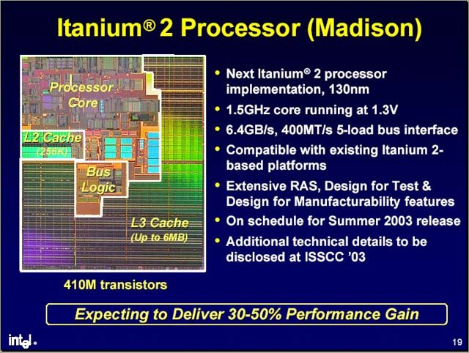
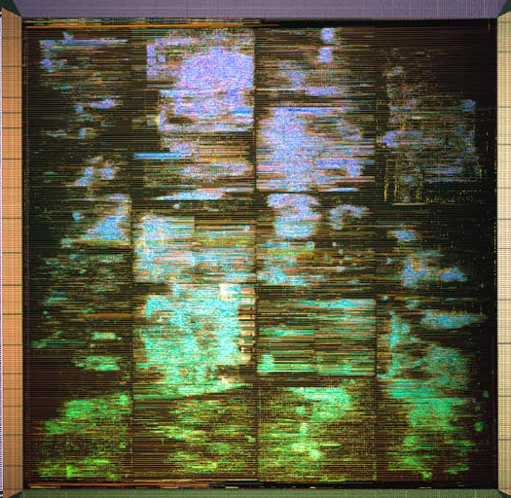
I2 vs NV30 Size
Itanium 2
Look at all that cache space!
NV30
32 * 4 = 128 FPU possible at 0.13 micron
+30% for PPCs at .1 micron + memory ???

Slide 28
PS3 ?
2 chip packages: BE + Graphics PEs
~6 PEs = 192 FPUs = 1.5 TFlops theoretically
DRAM
DRAM
PU
PU
PU
PU
PU
PU
PU
PU
Peripheral
DMAC
DMAC
DMAC
DMAC
DMAC
DMAC
DMAC
DMAC
IOP
APU
APU
APU
APU
APU
APU
APU
APU
APU
APU
APU
APU
APU
APU
APU
APU
APU
APU
APU
APU
APU
APU
APU
APU
I/O ASIC
APU
APU
APU
APU
APU
APU
APU
APU
APU
APU
APU
APU
Pixel
Engine
Pixel
Engine
Pixel
Engine
Pixel
Engine
APU
APU
APU
APU
Image
Cache
Image
Cache
Image
Cache
Image
Cache
APU
APU
APU
APU
External
Memory
APU
APU
APU
APU
CRTC
CRTC
CRTC
CRTC
Video

Slide 29
Memory Configuration
64 MB shared among PEs preferably
  64 MB on one Broadband Engine
Memory is divided into 1 MB banks
  Smallest addressable unit within a bank is 1024 bits
Bank controller controls 8 banks (8 MB)
  8 controllers = 64 MB
DMAC of PE can talk to any bank
Switch unit allows APUs on other BEs to access DRAM

Slide 30
Memory Diagram
From other BEs
8
8
8
8
8
APU
..
APU
PU
APU
..
APU
PU
APU
..
APU
PU
APU
..
APU
PU
DMAC
DMAC
DMAC
DMAC
Switch
Bank
= 1 MB
Cross
Bar
Bank Control
8 Bank Controllers Total
Bank Control
……………….
Bank
Bank
Bank
Bank
Bank
Bank
Bank
Bank
Bank
Bank
Bank
Bank
Bank
Bank
Bank
Bank
To Other
Switch Units
To Other
Switch Units
8 Banks

Slide 31
Direct Writing Across BEs
BE 1
APU
DMAC
Bank Controller
…
Bank
Bank
Bank
Bank
APU
BE 2
Switch
Bank Controller
Bank
Bank
Bank
Bank

Slide 32
Synchronization
All APUs can work independently
  Sounds like a memory nightmare
Synchronization is done in hardware
  Avoids software overhead
Memories on both ends have additional status information
Each 1024 bit addressable memory chunk in DRAM has
  Full/Empty bit
  Memory for APU ID and APU LS address
Each APU has
  Busy bit for each addressable part of local storage

Slide 33
Synchronization II
Full/Empty Bit – data is current if equals 1
  APU cannot read the data if it is 0
  APU leaves its ID and local storage address
    Second APU would be denied
Busy bit
  If 1, APU can use to write info from DRAM
  If 0, APU can write any data

Slide 34
Diagrams
Memory Control
REG
APU
LS
Local
Storage
(128 KB)
Busy
Bit
Data
1024 bits
instruction
…
F/E
Bit
APU
ID
LS
Address
Data
DRAM
Bank
1024 bits
…
…
…
…

Slide 35
Example I: LS → DRAM
APU Local Storage
DRAM Bank
Busy
Bit
F/E
Bit
APU
ID
LS
Address
Data
Data
XXX
0
Write
Since the F/E Bit is 0, the memory is empty and it is OK to write
Busy
Bit
F/E
Bit
APU
ID
LS
Address
Data
Data
1
XXX
If an APU tries to write with F/E = 1 they receive an error message

Slide 36
Example II: DRAM → LS
APU Local Storage
DRAM Bank
Busy
Bit
F/E
Bit
APU
ID
LS
Address
Data
Data
0
1
XXX
To initiate the read, the APU sets the LS Busy Bit to 1 (no writes)
Busy
Bit
F/E
Bit
APU
ID
LS
Address
Data
Data
1
1
XXX
Read
The Read command is issued from the APU
Busy
Bit
F/E
Bit
APU
ID
LS
Address
Data
Data
1
0
XXX
F/E bit set to 0
Busy
Bit
F/E
Bit
APU
ID
LS
Address
Data
Data
1
XXX
0
Data transferred
APU
ID
LS
Address
Busy
Bit =0
Busy
Bit
Data
F/E
Bit
Data
0
XXX
0

Slide 37
Example III: F/E 0 Read
APU 1 Local Storage
APU 2 Local Storage
DRAM Bank
Busy
Bit
Busy
Bit
F/E
Bit
APU
ID
LS
Address
Data
Data Location 12
Data
9798
1
0
9798
1
0
R
9798
1
0
2
12
1
0
2
12
9798
1
0
9798
1
9798
0
0
9798
0
Little PU intervention required

Slide 38
Memory Management
DRAM can be divided into “sandboxes”
  An area of memory beyond which an APU or set of APUs cannot read or write
  Implemented in hardware
PU controls the sandboxes
  Builds and maintains a key control table
  Each entry has an APU ID, an APU key, and key mask (for groups of APUs)
  Table in SRAM

Slide 39
Sandboxes cont’d
APU sends R/W request to DMAC
  DMAC looks at key for that APU and checks it against key for storage location for a match
Key Control Table
APU ID
0
APU Key
Key Mask
F/E
Bit
APU
ID
LS
Address
Data
KEY
1024 bits
1
APU Key
Key Mask
2
APU Key
Key Mask
…
7
APU Key
Key Mask
In DRAM
Associated with DMAC on PE

Slide 40
Alternatively
Also described another way on the PU
  Entry for each sandbox in the DRAM
  Describe sandbox start address and size
Memory Access Control Table (on PU)
Sandbox
ID
0
Base
Size
Access Key
Access Key Mask
1
Base
Size
Access Key
Access Key Mask
2
Base
Size
Access Key
Access Key Mask
…..
…..
63
Base
Size
Access Key
Access Key Mask

Slide 41
Programming Model
Based on “software cells”
  Processed directly by APUs and APU LS
  Loaded by PU
Software cell has two parts
  Routing information
    destination ID, source ID, reply ID
    ID has an IP address and extra info on PE and APU
  Body
    Global unique ID
    Required APUs
    Sandbox size
    Program
    Data
    Previous Cell ID (for streaming data)

Slide 42
Software Cell
Header
Global Unique ID
# APUs Needed
Sandbox Size
ID of prev. Cell
Header
VID
load
addr
LSaddr
Destination ID
VID
load
addr
LSaddr
Source ID
Reply ID
VID
kick
PC
Header
VID
kick
PC
DMA Commands
APU Program
“apulet”
APU Commands
Data
APU Program
Data

Slide 43
Cell Commands
DMA Command
VID = virtual ID of an APU
  Mapped to a physical ID
Load = load data from DRAM into LS
  APU program or data
Addr = virtual address in DRAM
LSAddr = location in LS to put info
VID
load
addr
LSaddr
DMA Kick Command
VID
kick
PC
Kick
  Command issued by PU to APU to initiate cell processing
PC = program counter
“APU #2 start processing commands at this program counter”

Slide 44
ARPC
To control the APUs, the PU issues commands like a remote procedure call
ARPC = APU Remote Procedure Call
  A series of DMA commands to the DMAC
  DMAC loads APU program and stack frame to LS of APU
    Stack frame includes parameters for subroutines, return address, local variables, parameters passed to next routine
  Then Kick to execute
APU signals PU via interrupt
PU also sets up sandboxes, keys, DRAM

Slide 45
Streaming Data
PU can set up APUs to receive data transmitetd over a network
PU can establish a dedicated pipeline between APUs and memory
  Apulet can reserve pipeline via “resident termination”
Can set up APUs for geometric transformations to generate display lists
  Further APUs generate pixel data
  Then onto Pixel Engine
That’s all the graphics they get into ☹

Slide 46
Time
Absolute timer independent of Ghz rating
Establishes time budget for computations
APU finishes computation, go into stanby mode (sleep mode for less power)
APU results are sent at the end of the timer
  Independent of actual APU speed
  Allows for coordination of APUs when faster cells are made
OR analyze program… insert NOOPs to maintain completion order

Slide 47
Time Diagram
Time Budget
Time Budget
APU0
Busy
Standby
Busy
Standby
Current Machine
APU1
Standby
Busy
APU2
Busy
Standby
Busy
Standby
APU7
Busy
Standby
Turn to
Sleep Mode
Wake Up
Low Power Mode
Time
Time Budget
Time Budget
Future Machine
(faster)
APU0
Busy
Standby
Busy
Standby
APU1
Standby
Busy
APU2
Less busy so less
power but not faster completion time
Busy
Standby
Busy
Standby
APU7
Busy
Standby

Slide 48
Conclusions I
1 Tflop?
  50M PS2s = 310 Petaflop, 5M PS3s = 5 Exaflops networked
Similar to streaming media processor
  SUN MAJC processor
  Small memories because data is flowing
  Sony understands bus/memory can kill performance
Tools seem pretty difficult to make
  Hard to wring out theoretical performance
  Making for a large middle-ware industry
  Steal supercomputer programmers (but even they only work on one app at a time, i.e. no integration of sound, gfx, physics)
  What about the OS? Linux?

Slide 49
Conclusions II
Designed for a broadband network
  Will consumers allow network programs to run on their PS3?
  Don’t count on broadband network
Maybe GDC will answer everything

